Slide 1

AUTO INSURANCE ENTERPRISE
Maguette Paye Nupur Mittal Pascal Nguyen Tang Shivangi Soni Vivek Saahil
DATA SCIENTIST
DATA SCIENTIST
DATA ANALYST
DATA ANALYST
BUSINESS ANALYST
Repository_Auto_Insurance_Enterprise

Slide 2
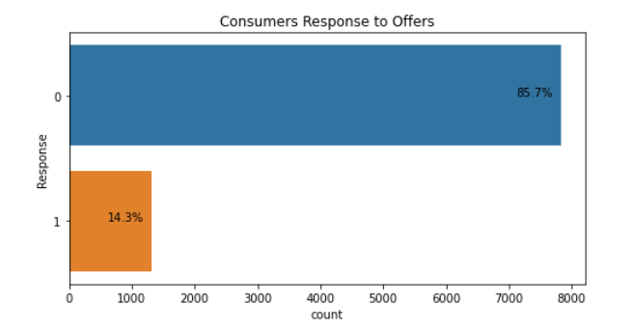
Context
Automotive Insurance Dataset, Synthetic Data – IBM Watson
Link: https://www.kaggle.com/pankajjsh06/ibm-watson-marketing-customer-value-data-
24 variables and 9,135 observations
14 policy profile variables and 10 customer profile variables
Policies of customers expiring within next two months
All customers were offered a renewal offer
Major Pain Point
14% of the customers accepted the renewal offer
Understanding the lower acceptance rate
Our solution
Regression – Predicting the Customer Lifetime Value
Take targeted actions to increase profitable customer response, retention, and growth
CLV > Cost of acquisition and retention
Classification – Determining whether the customer would respond to the offer
Understanding which customers would respond negatively and target those
Notes:
Use predictive analytics to analyze the most profitable customers and how they interact.
Knowing each customer’s customer lifetime value helps you know how much you should be spending on customer acquisition. A customer’s acquisition cost could be more than what they spend on their purchase, but if you nurture that relationship, their CLV may grow to an amount that’s well worth the investment. That’s just one of the many reasons why success in the customer-centered economy means understanding the importance of customer lifetime value.

Slide 3
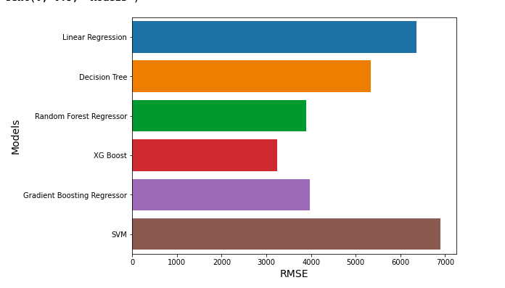
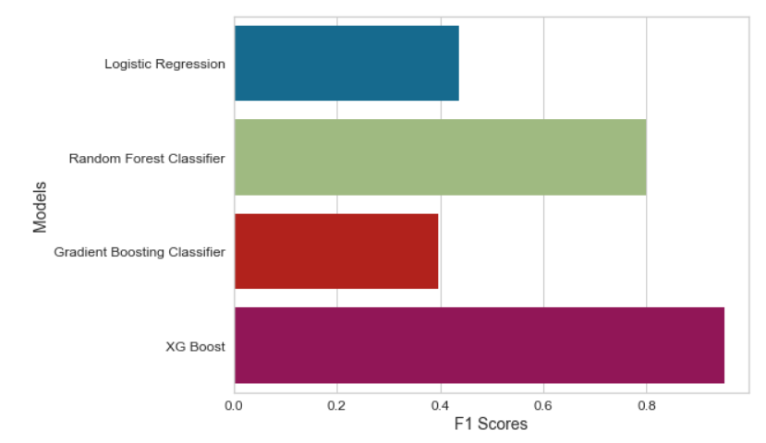
Modeling RESULTS
RMSE- Regression
F1 Scores - Classification
XGBOOST performed best for both Regression and Classification tasks, as shown by the RMSE and F1 Scores.
F1 Scores were used as performance metrics as opposed to precision, accuracy and recall because it is better suited for imbalanced data sets.
XGBOOST had the lowest RMSE of $3,250 and the highest F1 score of 0.9508.

Slide 4
RESULTS AND CAUSAL INFERENCE
Causal Inference
Treatment Variable | Outcome | P-value | Causal Estimate
Employment Status | Response | 2.06e-185 | 0.30
Employment Status | Customer Lifetime Value | 0.55 | -231.57
Renewed Offer 2¹ | Response | 1.91e-72 | 0.14
Renewed Offer 2¹ | Customer Lifetime Value | 2.79e-05 | -600.89
Coverage² | Response | 0.37 | 0.012
Coverage² | Customer Lifetime Value | 0.10 | -406.53
Income³ | Response | 0.536 | -0.0086
Income³ | Customer Lifetime Value | 0.36 | -240.85
¹ Offer 2 was found to be the most popular offer
² Coverage was either listed as Premium or not
³ Income is listed as true if above average

Slide 5



THREATS TO VALIDITY
Threats due to assumptions
“No” in Response means Customer Lifetime Value is stopped.
Uncertainties and Risks
There may be a relationship between low amounts of Customer Lifetime Value with the Response value “No”, which can skew our predictions.
Data Quality Issue Risks
The lack of data dictionaries made it difficult to make business interpretations.
High imbalance in data.

Slide 6
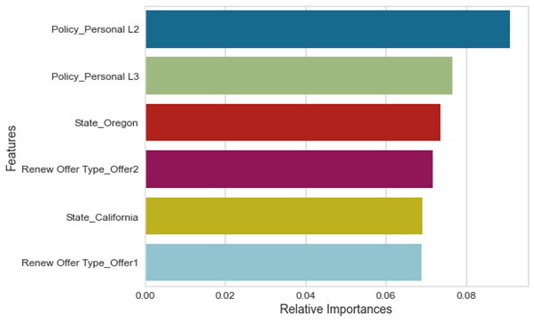
EXPLAINABILITY AND Feature Importance
Feature Importance
Policies were divided into multiple categories, which were themselves divided into 3 partitions: L1, L2 and L3. The Offer type for the renewal of a given policy was divided into 4 partitions.
The graph shows the most impactful features on the classification model.

Slide 7
BUSINESS IMPLICATIONS
Targeting consumers with high CLV who were predicted to respond negatively to offers
Providing other offer options to gauge their interest
Offering Offer 2 to more consumers
Causal Inference Recommendation
Focus on developing similar offers to Offer 2
Focusing on volume

Slide 8
Lessons learnt and next steps
Lessons learnt
Data is not enough to answer the 'why' of the problem
Data overlay maybe required to determine a strategy
Need to SMEs to understand the features/data better
Understood how different roles come together
Next Steps (from company's perspective)
Understanding who your customers are and what's driving them
Conducting surveys to determine what kind of offers people would be willing to accept
Understanding the reason of people rejecting the offer
Understanding if giving multiple offers would improve the acceptance rate
Renewal offers should be distributed after understanding different customer segments
Personalizing the type of offers being provided to customers

Slide 9
Appendix

Slide 10
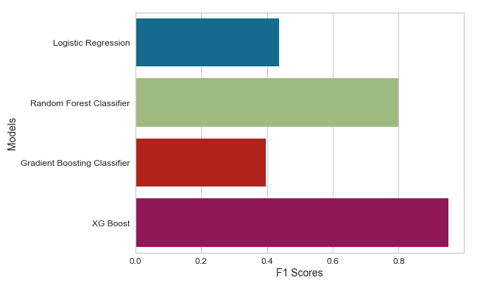
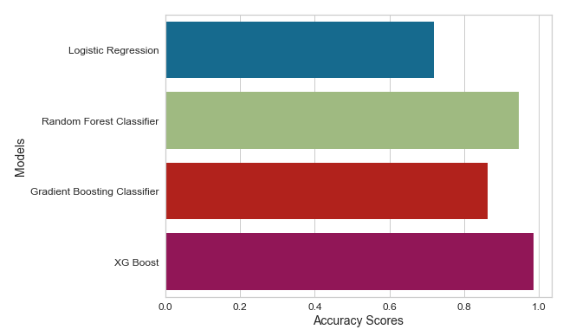
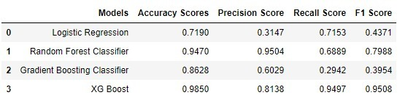
F1 scores and Accuracy scores – Classification

Slide 11
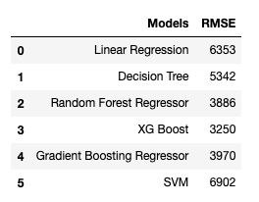
RMSE

Slide 12
Feature importance

